Slide 1

SR University
Course : AI Assistant Coding
Instructor : Dr. Sallauddin Mohammed
Title : University Fee Management
Team Details : Pogalla Bhargavi (2303A51161)

Slide 2
SR University
Introduction :
The University Fee Management System is a full-stack web application that allows students to:
View fee details
Check payment status
Download fee receipts
The system also includes an Admin Panel to manage:
Student records
Fee assignments
Payment tracking
Receipt downloads

Slide 3
SR University
Objective :
Build a full-stack application using Flask and SQLite
Provide a simple and efficient fee management system
Implement secure authentication and role-based access
Enable students to track and download fee details
Allow admins to manage student fees easily
Apply AI-assisted development for faster coding

Slide 4
SR University
Stakeholders :
Users: View and manage their fee details
Admin: Manage students, fees, and payments
Developers: Develop and maintain the system
Institution: Ensure smooth fee management

Slide 5
SR University
Technologies Used :
Frontend:
Html
CSS (Bootstrap)
JavaScript
Backend:
Python (Flask)
Database:
SQLite
Tools:
GitHub
VS Code
Authentication:
Password hashing
Session-based authentication

Slide 6
SR University
AI Prompts Used :
“Generate student dashboard with fee table and status badges”
“Allow the admin to download all the student receipts”
"Fix authentication issues in Flask login system"
"Create PDF receipt generation using Python"
"Design admin panel with CRUD operations for fees"

Slide 7
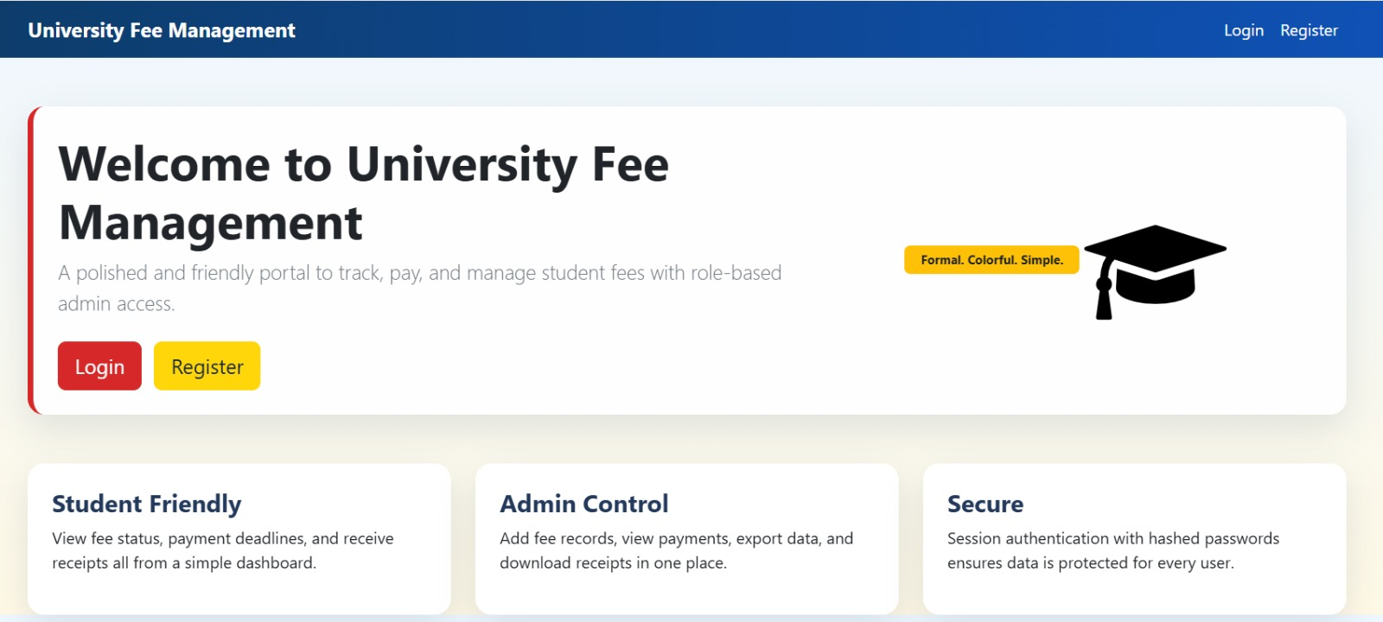
SR University

Slide 8
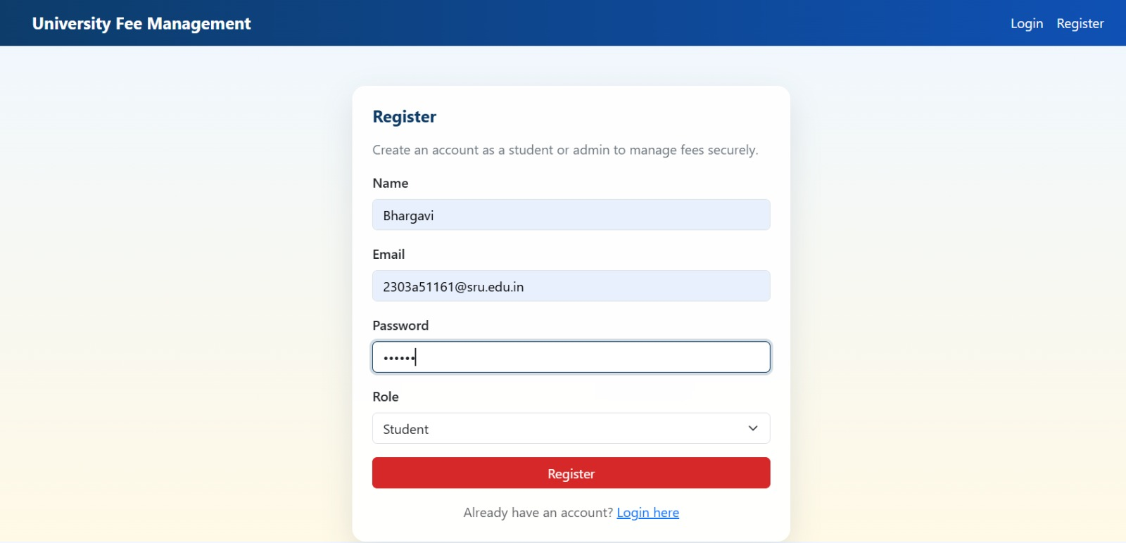
SR University

Slide 9
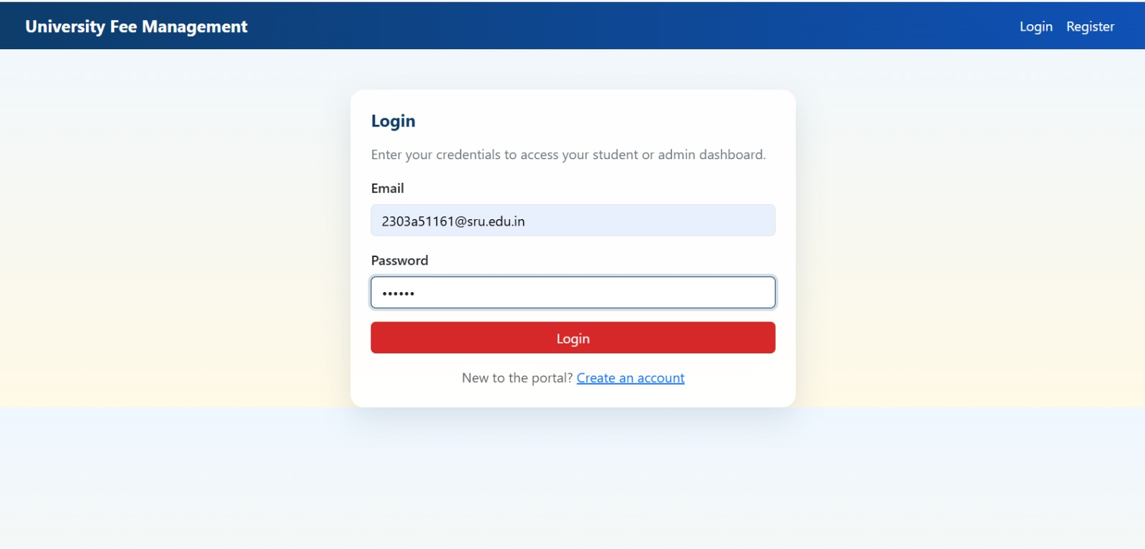
SR University

Slide 10
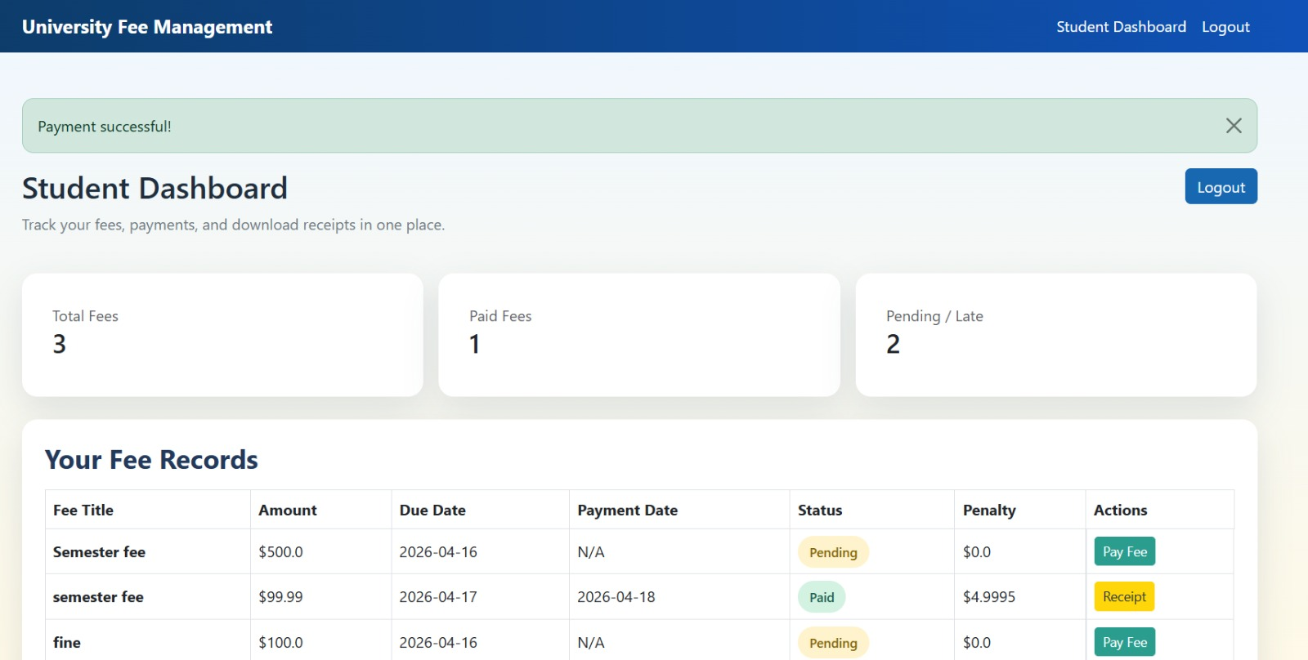
SR University

Slide 11
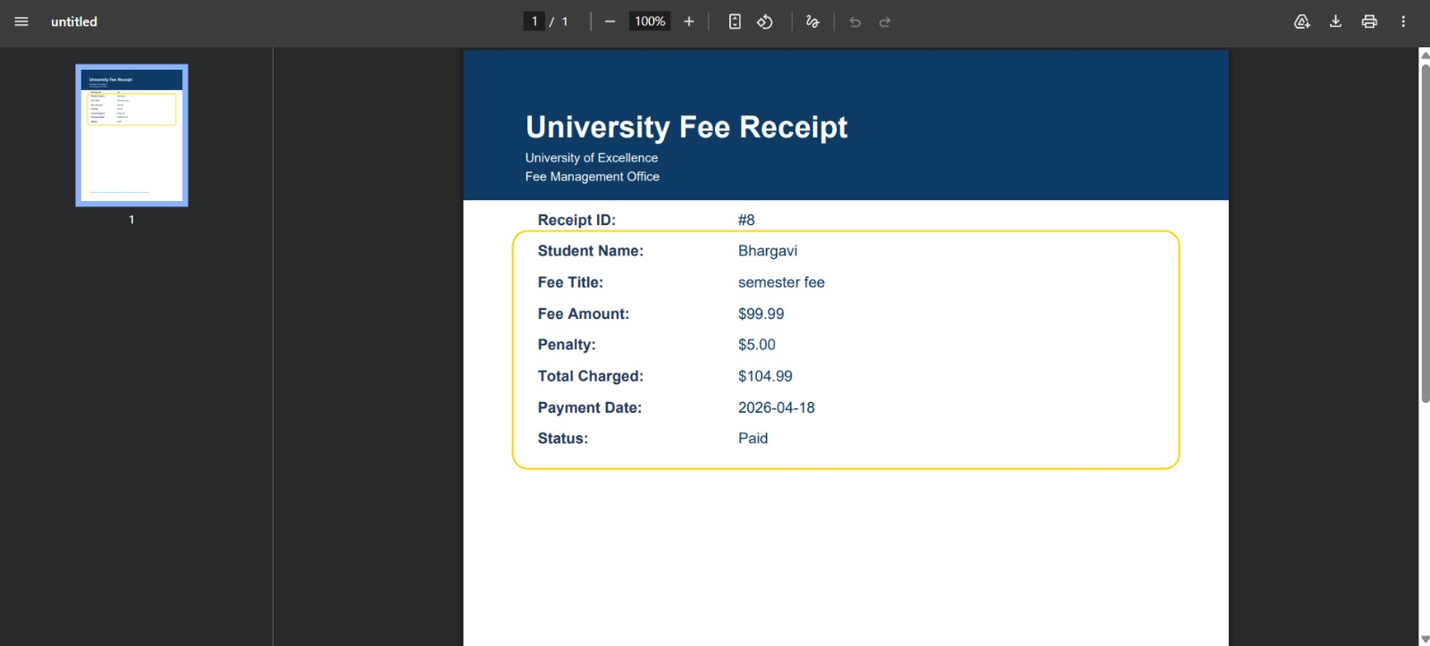
SR University

Slide 12
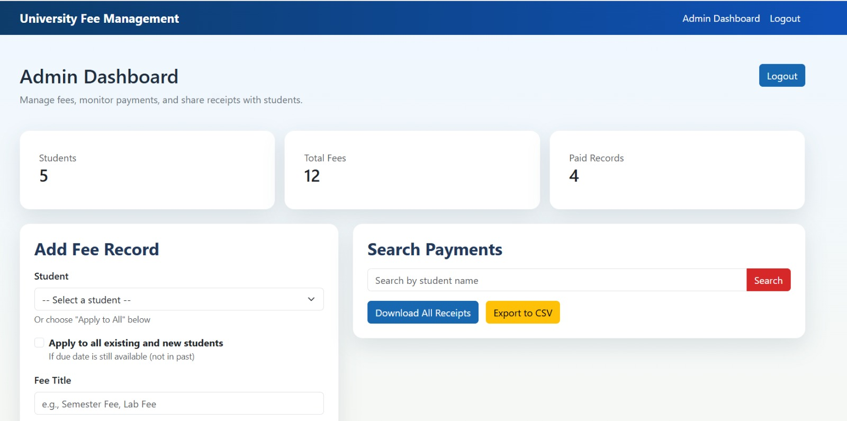
SR University

Slide 13
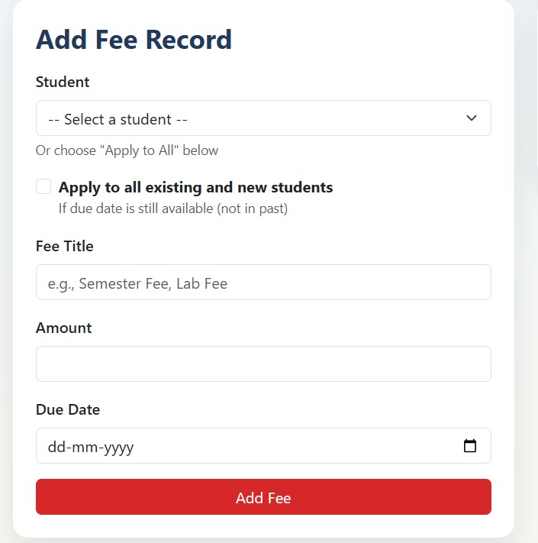
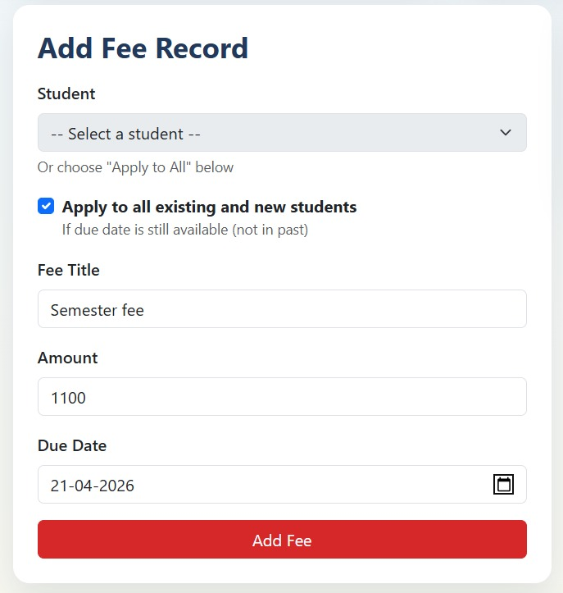

Slide 14
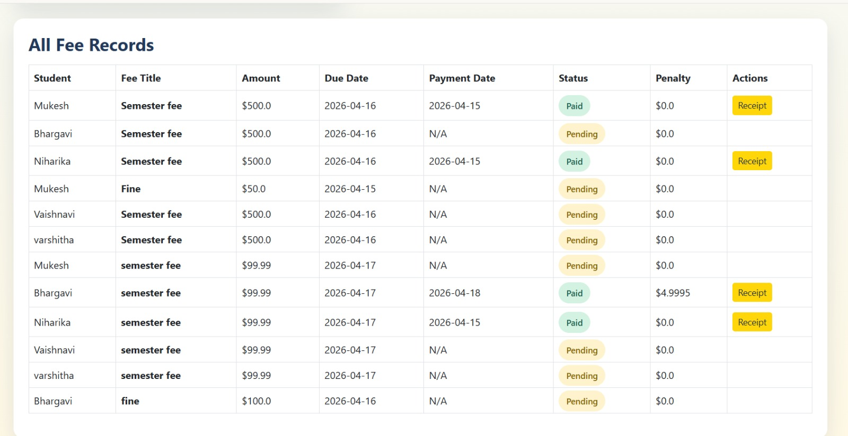

Slide 15
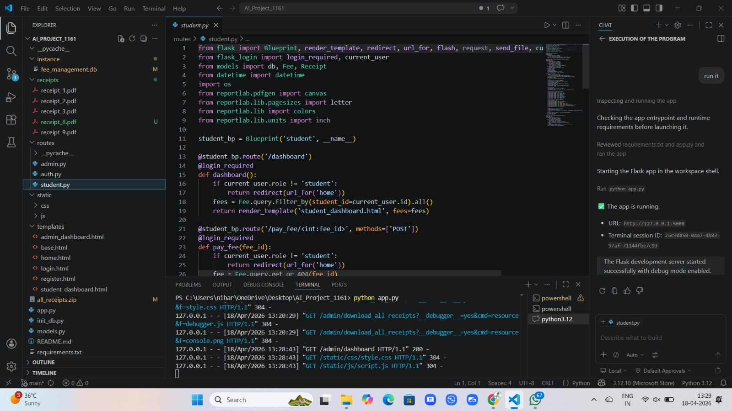
SR University
Code in VS Code :

Slide 16
SR University

Slide 17
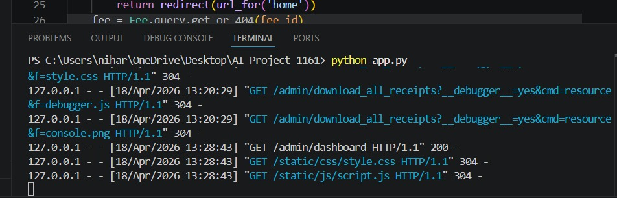
SR University

Slide 18
SR University
References
Flask Official Documentation
SQLite Documentation
Bootstrap Documentation
Python Documentation
ChatGPT (OpenAI)
Stack Overflow
MDN Web Docs

Slide 19
SR University
Github Link
https://github.com/Bhargavi9007/AI_Project_1161

Slide 20
SR University
THANK YOU!

